Slide 1

Information Security
CS-321
Sir Syed University of Engineering & Technology, Karachi
Razia Nisar Noorani
Asst.Prof

Slide 2
Chapter 0 – CIS
Short discussion on
Course Information Sheet
Notes:
This quote from the start of Ch0 ”Reader’s Guide” sets the scene for why we want to study these issues.

Slide 3
Marks Distribution
Assignments
Quizzes
Mid Term
Final Exam

Slide 4
Do not figure on opponents not attacking; worry about your own lack of preparation

Slide 5
What Is Security?
Security is protection. Protection from adversaries—those who would do harm, intentionally or otherwise—is the ultimate objective of security.

Slide 6
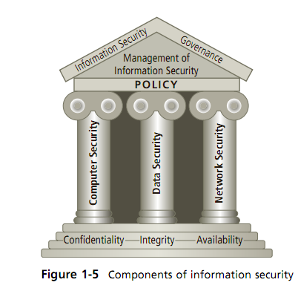

Slide 7
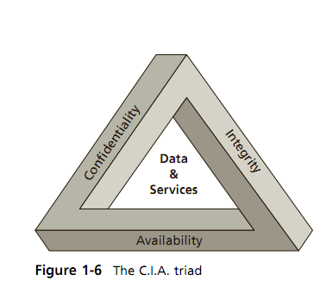

Slide 8
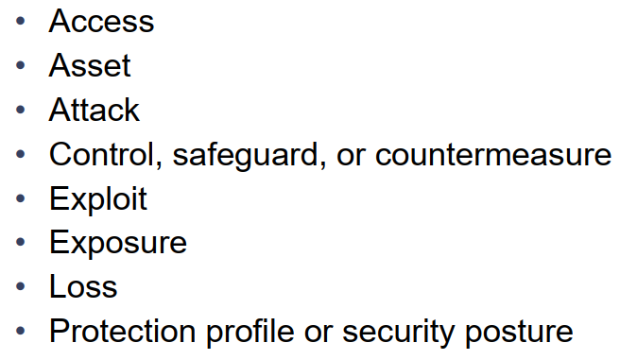
Key Information Security Concepts

Slide 9
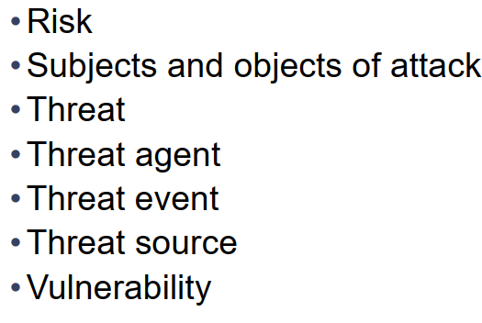
Key Information Security Concepts

Slide 10
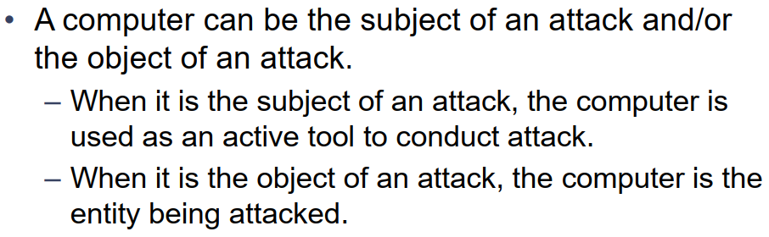
Key Information Security Concepts

Slide 11
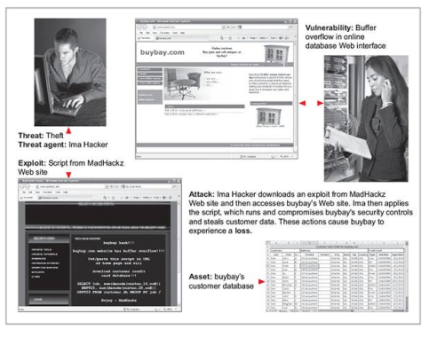

Slide 12
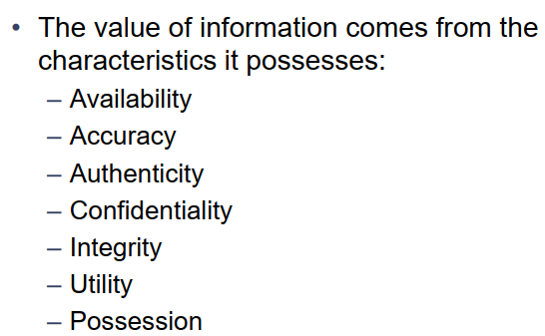
Critical characteristics of Information

Slide 13
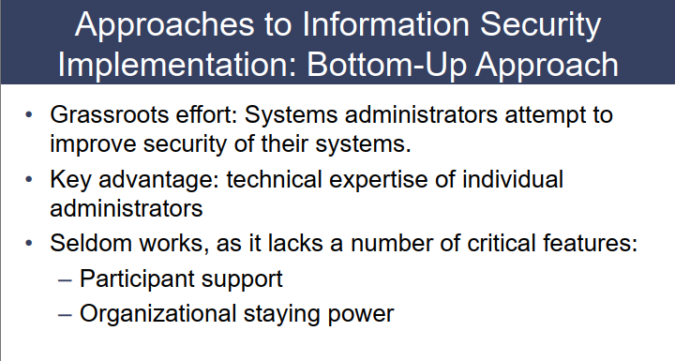

Slide 14
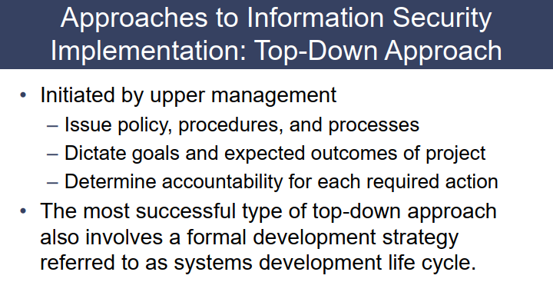

Slide 15
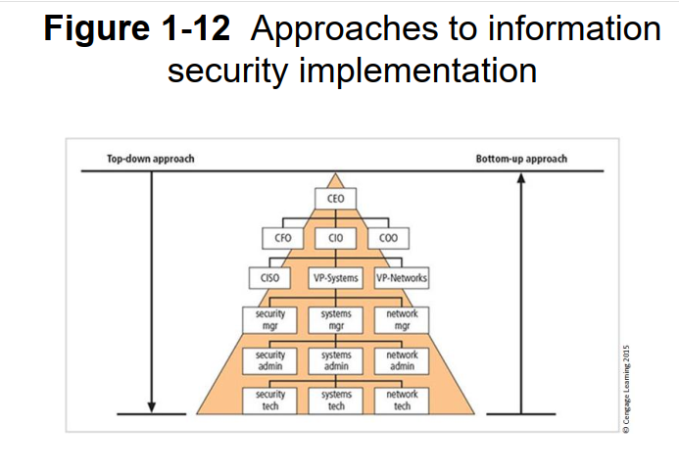

Slide 16
Cryptography
Cryptography is the study of secure communications techniques that allow only the sender and intended recipient of a message to view its contents. ... Here, data is encrypted using a secret key, and then both the encoded message and secret key are sent to the recipient for decryption.

Slide 17
What is network security and why do we need it?
Network security is any action an organization takes to prevent malicious use or accidental damage to the network's private data, its users, or their devices.
The goal of network security is to keep the network running and safe for all legitimate users.

Slide 18
Standards Organizations
National Institute of Standards & Technology (NIST)
Internet Society (ISOC)
International Telecommunication Union Telecommunication Standardization Sector (ITU-T)
International Organization for Standardization (ISO)
RSA Labs (de facto)
Notes:
Throughout this book, we describe the most important standards in use or being developed for various aspects of cryptography and
network security. Various organizations have been involved in the development or promotion of these standards including:
• NIST is a U.S. federal agency that deals with measurement science, standards, and technology related to U.S. government use
and to the promotion of U.S. private-sector innovation. Despite its national scope, NIST Federal Information Processing Standards (FIPS) and Special Publications (SP) have a worldwide impact.
• ISOC is a professional membership society with worldwide organizational and individual membership. It provides leadership in addressing issues that confront the future of the Internet and is the organization home for the groups responsible for Internet infrastructure standards, including the Internet Engineering Task Force (IETF) and the Internet Architecture Board (IAB). These organizations develop Internet standards and related specifications, all of which are published as Requests for Comments (RFCs).
• ITU is an international organization within the United Nations System in which governments and the private sector coordinate global telecom networks and services The ITU Telecommunication Standardization Sector (ITU-T) is one of the three sectors of the ITU. ITU-T's mission is the production of standards covering all fields of telecommunications. ITU-T standards are referred to as Recommendations.
• ISO is a worldwide federation of national standards bodies from more than 140 countries, one from each country. ISO is a nongovernmental organization that promotes the development of standardization and related activities with a view to facilitating the international exchange of goods and services, and to developing cooperation in the spheres of intellectual, scientific, technological, and economic activity. ISO's work results in international agreements that are published as International Standards.

Slide 19
Background
Information Security requirements have changed in recent times (due to attacks on sensitive info.)
Traditionally provided by physical and administrative mechanisms
Computer use requires automated tools to protect files and other stored information
Use of networks and communications links requires measures to protect data during transmission
Notes:
The requirements of information security within an organization have undergone two major changes in the last several decades. Before the widespread use of data processing equipment,the security of information felt to be valuable to an organization was provided primarily by physical (eg. rugged filing cabinets with locks) and administrative mechanisms (eg. Personnel screening procedures during hiring process).
Growing computer use implies a need for automated tools for protecting files and other information stored on it. This is especially the case for a shared system, such as a time-sharing system, and even more so for systems that can be accessed over a public telephone network, data network, or the Internet.
The second major change that affected security is the introduction of distributed systems and the use of networks and communications facilities for carrying data between terminal user and computer and between computer and computer. Network security measures are needed to protect data during their transmission.

Slide 20
Definitions
Computer Security - generic name for the collection of tools designed to protect data and to thwart hackers
Network Security - measures to protect data during their transmission
Internet Security - measures to protect data during their transmission over a collection of interconnected networks
Notes:
Here are some key definitions, note boundaries between them are blurred.

Slide 21
Computer Security
Can be elaborated as:
The protection afforded to an automated information system in order to attain the applicable objectives of preserving the integrity, availability and confidentiality of information system resources (includes hardware, software, firmware, information/data, and telecommunications)
Notes:
The NIST Computer Security Handbook [NIST95] defines the term computer security as shown on this slide. This definition introduces three key objectives that are at the heart of computer security as we see on the next slide.
In electronic systems and computing, firmware is a tangible electronic component with embedded software instructions

Slide 22
Levels of Impact
can define 3 levels of impact from a security breach
  Low
  Moderate
  High
Notes:
We can define three levels of impact on organizations or individuals should there be a breach of security (i.e., a loss of confidentiality, integrity, or availability). These levels are defined in FIPS PUB 199:
• Low: The loss could be expected to have a limited adverse effect on organizational operations, organizational assets, or individuals. A limited adverse effect means that, for example, the loss of confidentiality, integrity, or availability might (i) cause a degradation in mission capability to an extent and duration that the organization is able to perform its primary functions, but the effectiveness of the functions is noticeably reduced; (ii) result in minor damage to organizational assets; (iii) result in minor financial loss; or (iv) result in minor harm to individuals.
• Moderate: The loss could be expected to have a serious adverse effect on organizational operations, organizational assets, or individuals. A serious adverse effect means that, for example, the loss might (i) cause a significant degradation in mission capability to an extent and duration that the organization is able to perform its primary functions, but the effectiveness of the functions is significantly reduced; (ii) result in significant damage to organizational assets; (iii) result in significant financial loss; or (iv) result in significant harm to individuals that does not involve loss of life or serious, life-threatening injuries.
• High: The loss could be expected to have a severe or catastrophic adverse effect on organizational operations, organizational assets, or individuals. A severe or catastrophic adverse effect means that, for example, the loss might (i) cause a severe degradation in or loss of mission capability to an extent and duration that the organization is not able to perform one or more of its primary functions; (ii) result in major damage to organizational assets; (iii) result in major financial loss; or (iv) result in severe or catastrophic harm to individuals involving loss of life or serious life threatening injuries.

Slide 23
Low Impact
The loss could be expected to have a limited adverse effect on organizational operations, organizational assets, or individuals.
A limited adverse effect means that, for example, the loss of confidentiality, integrity, or availability might
  (i) cause a degradation in mission capability to an extent and duration that the organization is able to perform its primary functions, but the effectiveness of the functions is noticeably reduced;
  (ii) result in minor damage to organizational assets;
  (iii) result in minor financial loss; or
  (iv) result in minor harm to individuals.
Notes:
We can define three levels of impact on organizations or individuals should there be a breach of security (i.e., a loss of confidentiality, integrity, or availability). These levels are defined in FIPS PUB 199:
• Low: The loss could be expected to have a limited adverse effect on organizational operations, organizational assets, or individuals. A limited adverse effect means that, for example, the loss of confidentiality, integrity, or availability might (i) cause a degradation in mission capability to an extent and duration that the organization is able to perform its primary functions, but the effectiveness of the functions is noticeably reduced; (ii) result in minor damage to organizational assets; (iii) result in minor financial loss; or (iv) result in minor harm to individuals.
• Moderate: The loss could be expected to have a serious adverse effect on organizational operations, organizational assets, or individuals. A serious adverse effect means that, for example, the loss might (i) cause a significant degradation in mission capability to an extent and duration that the organization is able to perform its primary functions, but the effectiveness of the functions is significantly reduced; (ii) result in significant damage to organizational assets; (iii) result in significant financial loss; or (iv) result in significant harm to individuals that does not involve loss of life or serious, life-threatening injuries.
• High: The loss could be expected to have a severe or catastrophic adverse effect on organizational operations, organizational assets, or individuals. A severe or catastrophic adverse effect means that, for example, the loss might (i) cause a severe degradation in or loss of mission capability to an extent and duration that the organization is not able to perform one or more of its primary functions; (ii) result in major damage to organizational assets; (iii) result in major financial loss; or (iv) result in severe or catastrophic harm to individuals involving loss of life or serious life threatening injuries.

Slide 24
Moderate Impact
The loss could be expected to have a serious adverse effect on organizational operations, organizational assets, or individuals.
A serious adverse effect means that, for example, the loss might
  (i) cause a significant degradation in mission capability to an extent and duration that the organization is able to perform its primary functions, but the effectiveness of the functions is significantly reduced;
  (ii) result in significant damage to organizational assets;
  (iii) result in significant financial loss; or
  (iv) result in significant harm to individuals that does not involve loss of life or serious, life-threatening injuries.
Notes:
We can define three levels of impact on organizations or individuals should there be a breach of security (i.e., a loss of confidentiality, integrity, or availability). These levels are defined in FIPS PUB 199:
• Low: The loss could be expected to have a limited adverse effect on organizational operations, organizational assets, or individuals. A limited adverse effect means that, for example, the loss of confidentiality, integrity, or availability might (i) cause a degradation in mission capability to an extent and duration that the organization is able to perform its primary functions, but the effectiveness of the functions is noticeably reduced; (ii) result in minor damage to organizational assets; (iii) result in minor financial loss; or (iv) result in minor harm to individuals.
• Moderate: The loss could be expected to have a serious adverse effect on organizational operations, organizational assets, or individuals. A serious adverse effect means that, for example, the loss might (i) cause a significant degradation in mission capability to an extent and duration that the organization is able to perform its primary functions, but the effectiveness of the functions is significantly reduced; (ii) result in significant damage to organizational assets; (iii) result in significant financial loss; or (iv) result in significant harm to individuals that does not involve loss of life or serious, life-threatening injuries.
• High: The loss could be expected to have a severe or catastrophic adverse effect on organizational operations, organizational assets, or individuals. A severe or catastrophic adverse effect means that, for example, the loss might (i) cause a severe degradation in or loss of mission capability to an extent and duration that the organization is not able to perform one or more of its primary functions; (ii) result in major damage to organizational assets; (iii) result in major financial loss; or (iv) result in severe or catastrophic harm to individuals involving loss of life or serious life threatening injuries.

Slide 25
High Impact
The loss could be expected to have a severe or catastrophic adverse effect on organizational operations, organizational assets, or individuals.
A severe or catastrophic adverse effect means that, for example, the loss might
  (i) cause a severe degradation in or loss of mission capability to an extent and duration that the organization is not able to perform one or more of its primary functions;
  (ii) result in major damage to organizational assets;
  (iii) result in major financial loss; or
  (iv) result in severe or catastrophic harm to individuals involving loss of life or serious life threatening injuries.
Notes:
We can define three levels of impact on organizations or individuals should there be a breach of security (i.e., a loss of confidentiality, integrity, or availability). These levels are defined in FIPS PUB 199:
• Low: The loss could be expected to have a limited adverse effect on organizational operations, organizational assets, or individuals. A limited adverse effect means that, for example, the loss of confidentiality, integrity, or availability might (i) cause a degradation in mission capability to an extent and duration that the organization is able to perform its primary functions, but the effectiveness of the functions is noticeably reduced; (ii) result in minor damage to organizational assets; (iii) result in minor financial loss; or (iv) result in minor harm to individuals.
• Moderate: The loss could be expected to have a serious adverse effect on organizational operations, organizational assets, or individuals. A serious adverse effect means that, for example, the loss might (i) cause a significant degradation in mission capability to an extent and duration that the organization is able to perform its primary functions, but the effectiveness of the functions is significantly reduced; (ii) result in significant damage to organizational assets; (iii) result in significant financial loss; or (iv) result in significant harm to individuals that does not involve loss of life or serious, life-threatening injuries.
• High: The loss could be expected to have a severe or catastrophic adverse effect on organizational operations, organizational assets, or individuals. A severe or catastrophic adverse effect means that, for example, the loss might (i) cause a severe degradation in or loss of mission capability to an extent and duration that the organization is not able to perform one or more of its primary functions; (ii) result in major damage to organizational assets; (iii) result in major financial loss; or (iv) result in severe or catastrophic harm to individuals involving loss of life or serious life threatening injuries.

Slide 26
Examples of Security Requirements
confidentiality – student grades
integrity – patient information
availability – authentication service
authenticity – admission ticket
non-repudiation – stock sell order
Notes:
We now provide some examples of applications that illustrate the requirements just enumerated.
• Confidentiality - Student grade information is an asset whose confidentiality is considered to be highly important by students. Grade information should only be available to students, their parents, and employees that require the information to do their job. Student enrollment information may have a moderate confidentiality rating. While still coveredby FERPA, this information is seen by more people on a daily basis, is less likely to be targeted than grade information, and results in less damage if disclosed. Directory information, such as lists of students or faculty or departmental lists, may be assigned a low confidentiality rating or indeed no rating. This information is typically freely available to the public and published on a school's Web site.
• Integrity – Consider a hospital patient's allergy information stored in a database. The doctor should be able to trust that the information is correct and current. Now suppose that an employee (e.g., a nurse) who is authorized to view and update this information deliberately falsifies the data to cause harm to the hospital. The database needs to be restored to a trusted basis quickly, and it should be possible to trace the error back to the person responsible. Patient allergy information is an example of an asset with a high requirement for integrity. Inaccurate information could result in serious harm or death to a patient and expose the hospital to massive liability.
• Availability - The more critical a component or service, the higher is the level of availability required. Consider a system that provides authentication services for critical systems, applications, and devices. An interruption of service results in the inability for customers to access computing resources and staff to access the resources they need to perform critical tasks. The loss of the service translates into a large financial loss in lost employee productivity and potential customer loss.

Slide 27
Confidentiality
Confidentiality - Student grade information is an asset whose confidentiality is considered to be highly important by students. Grade information should only be available to students, their parents, and employees that require the information to do their job. Student enrollment information may have a moderate confidentiality rating. This information is seen by more people on a daily basis, is less likely to be targeted than grade information, and results in less damage if disclosed. Directory information, such as lists of students or faculty or departmental lists, may be assigned a low confidentiality rating or indeed no rating. This information is typically freely available to the public and published on a school's Web site.

Slide 28
Integrity
Consider a hospital patient's allergy information stored in a database. The doctor should be able to trust that the information is correct and current. Now suppose that an employee (e.g., a nurse) who is authorized to view and update this information deliberately falsifies the data to cause harm to the hospital. The database needs to be restored to a trusted basis quickly, and it should be possible to trace the error back to the person responsible. Patient allergy information is an example of an asset with a high requirement for integrity. Inaccurate information could result in serious harm or death to a patient and expose the hospital to massive liability.

Slide 29
Availability
The more critical a component or service, the higher is the level of availability required. Consider a system that provides authentication services for critical systems, applications, and devices. An interruption of service results in the inability for customers to access computing resources and staff to access the resources they need to perform critical tasks. The loss of the service translates into a large financial loss in lost employee productivity and potential customer loss.

Slide 30
Computer Security Challenges
not simple – easy to get it wrong
must consider potential attacks
procedures used counter-intuitive
involve algorithms and secret info
must decide where to deploy mechanisms
battle of wits between attacker / admin
not perceived on benefit until fails
requires regular monitoring a process, not an event
too often an after-thought
regarded as impediment to using system
“Unusable security is not secure”
Notes:
Computer security is both fascinating and complex. Some of the reasons follow:
1. Computer security is not as simple as it might first appear to the novice. The requirements seem to be straightforward, but the mechanisms used to meet those requirements can be quite complex and subtle.
2. In developing a particular security mechanism or algorithm, one must always consider potential attacks (often unexpected) on those security features.
3. Hence procedures used to provide particular services are often counterintuitive.
4. Having designed various security mechanisms, it is necessary to decide where to use them.
5. Security mechanisms typically involve more than a particular algorithm or protocol, but also require participants to have secret information, leading to issues of creation, distribution, and protection of that secret information.
6. Computer security is essentially a battle of wits between a perpetrator who tries to find holes and the designer or administrator who tries to close them.
7. There is a natural tendency on the part of users and system managers to perceive little benefit from security investment until a security failure occurs.
8. Security requires regular monitoring, difficult in today's short-term environment.
9. Security is still too often an afterthought - incorporated after the design is complete.
10. Many users / security administrators view strong security as an impediment to efficient and user-friendly operation of an information system or use of information.

Slide 31
OSI Security Architecture
ITU-T X.800 “Security Architecture for OSI”
Defines a systematic way of defining and providing security requirements
For us it provides a useful, if abstract, overview of concepts we will study
Notes:
To assess effectively the security needs of an organization and to evaluate and choose various security products and policies, the manager responsible for security needs some systematic way of defining the requirements for security and characterizing the approaches to satisfying those requirements. This is difficult enough in a centralized data processing environment; with the use of local and wide area networks the problems are compounded. ITU-T Recommendation X.800, Security Architecture for OSI, defines such a systematic approach. The OSI security architecture is useful to managers as a way of organizing the task of providing security.

Slide 32
Aspects of Security
consider 3 aspects of information security:
  security attack
  security mechanism (control)
  security service
note terms
  threat – a potential for violation of security
  vulnerability – a way by which loss can happen
  attack – an assault on system security, a deliberate attempt to evade security services
Notes:
The OSI security architecture focuses on security attacks, mechanisms, and services. These can be defined briefly as follows:
• Security attack: Any action that compromises the security of information owned by an organization.
• Security mechanism: A process (or a device incorporating such a process) that is designed to detect, prevent, or recover from a security attack.
• Security service: A processing or communication service that enhances the security of the data processing systems and the information transfers of an organization. The services are intended to counter security attacks, and they make use of one or more security mechanisms to provide the service.
In the literature, the terms threat and attack are commonly used to mean more or less the same thing. Table 1.1 provides definitions taken from RFC 2828, Internet Security Glossary.
Threat - A potential for violation of security, which exists when there is a circumstance, capability, action, or event that could breach security and cause harm. That is, a threat is a possible danger that might exploit a vulnerability.
Attack - An assault on system security that derives from an intelligent threat; that is, an intelligent act that is a deliberate attempt (especially in the sense of a method or technique) to evade security services and violate the security policy of a system.

Slide 33
Attacks, Services and Mechanisms
Security Attack: Any action that compromises the security of information.
Security Mechanism: A mechanism that is designed to detect, prevent, or recover from a security attack.
Security Service: A service that enhances the security of data processing systems and information transfers. A security service makes use of one or more security mechanisms.

Slide 34
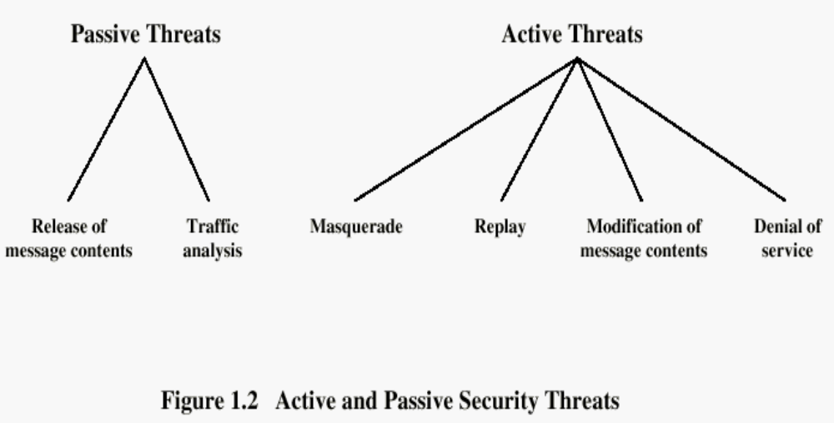
Security Attacks
Learning Assignment: In the notes (below)
Notes:
Learning Assignment: I intentionally included this figure. Attacks have different names. See this topic in the book and Note down the name of these attacks.

Slide 35
Security Attacks
Passive attacks: are in the nature of eavesdropping on, or monitoring of, transmissions
Goal of the opponent is to obtain information that is being transmitted
Active attacks: involve some modification of the data stream or the creation of a false stream

Slide 36

Passive Attack - Interception
This is an attack on confidentiality
Notes:
A useful means of classifying security attacks, used both in X.800 and RFC 2828, is in terms of passive attacks and active attacks. A passive attack attempts to learn or make use of information from the system but does not affect system resources.
Passive attacks are in the nature of eavesdropping on, or monitoring of, transmissions. The goal of the opponent is to obtain information that is being transmitted. Two types of passive attacks are:
+ release of message contents - as shown above in Stallings Figure 1.2a here
+ traffic analysis - monitor traffic flow to determine location and identity of communicating hosts and could observe the frequency and length of messages being exchanged
These attacks are difficult to detect because they do not involve any alteration of the data.

Slide 37
Passive Attack: Traffic Analysis
Observe traffic pattern
Notes:
A useful means of classifying security attacks, used both in X.800 and RFC 2828, is in terms of passive attacks and active attacks. A passive attack attempts to learn or make use of information from the system but does not affect system resources.
Passive attacks are in the nature of eavesdropping on, or monitoring of, transmissions. The goal of the opponent is to obtain information that is being transmitted. Two types of passive attacks are:
+ release of message contents - as shown above in Stallings Figure 1.2a here
+ traffic analysis - monitor traffic flow to determine location and identity of communicating hosts and could observe the frequency and length of messages being exchanged
These attacks are difficult to detect because they do not involve any alteration of the data.

Slide 38
Active Attack: Interruption
Block delivery of message
This is an attack on availability
Notes:
A useful means of classifying security attacks, used both in X.800 and RFC 2828, is in terms of passive attacks and active attacks. A passive attack attempts to learn or make use of information from the system but does not affect system resources.
Passive attacks are in the nature of eavesdropping on, or monitoring of, transmissions. The goal of the opponent is to obtain information that is being transmitted. Two types of passive attacks are:
+ release of message contents - as shown above in Stallings Figure 1.2a here
+ traffic analysis - monitor traffic flow to determine location and identity of communicating hosts and could observe the frequency and length of messages being exchanged
These attacks are difficult to detect because they do not involve any alteration of the data.

Slide 39
Active Attack: Fabrication
Fabricate message
This is an attack on authenticity
Notes:
A useful means of classifying security attacks, used both in X.800 and RFC 2828, is in terms of passive attacks and active attacks. A passive attack attempts to learn or make use of information from the system but does not affect system resources.
Passive attacks are in the nature of eavesdropping on, or monitoring of, transmissions. The goal of the opponent is to obtain information that is being transmitted. Two types of passive attacks are:
+ release of message contents - as shown above in Stallings Figure 1.2a here
+ traffic analysis - monitor traffic flow to determine location and identity of communicating hosts and could observe the frequency and length of messages being exchanged
These attacks are difficult to detect because they do not involve any alteration of the data.

Slide 40

Active Attack: Replay
Notes:
Active attacks involve some modification of the data stream or the creation of a false stream and can be subdivided into four categories: masquerade, replay, modification of messages, and denial of service:
masquerade of one entity as some other
replay previous messages (as shown above in Stallings Figure 1.3b)
modify/alter (part of) messages in transit to produce an unauthorized effect
denial of service - prevents or inhibits the normal use or management of communications facilities
Active attacks present the opposite characteristics of passive attacks. Whereas passive attacks are difficult to detect, measures are available to prevent their success. On the other hand, it is quite difficult to prevent active attacks absolutely, because of the wide variety of potential physical, software, and network vulnerabilities. Instead, the goal is to detect active attacks and to recover from any disruption or delays caused by them.

Slide 41
Active Attack: Modification
Modify message
This is an attack on integrity
Notes:
Active attacks involve some modification of the data stream or the creation of a false stream and can be subdivided into four categories: masquerade, replay, modification of messages, and denial of service:
masquerade of one entity as some other
replay previous messages (as shown above in Stallings Figure 1.3b)
modify/alter (part of) messages in transit to produce an unauthorized effect
denial of service - prevents or inhibits the normal use or management of communications facilities
Active attacks present the opposite characteristics of passive attacks. Whereas passive attacks are difficult to detect, measures are available to prevent their success. On the other hand, it is quite difficult to prevent active attacks absolutely, because of the wide variety of potential physical, software, and network vulnerabilities. Instead, the goal is to detect active attacks and to recover from any disruption or delays caused by them.

Slide 42
Handling Attacks
  Passive attacks – focus on Prevention
    Easy to stop
    Hard to detect
  Active attacks – focus on Detection and Recovery
    Hard to stop
    Easy to detect
Notes:
Consider the role of a security service, and what may be required.
Note both similarities and differences with traditional paper documents, which for example:
have signatures & dates;
need protection from disclosure, tampering, or destruction;
may be notarized or witnessed;
may be recorded or licensed

Slide 43
Week-1
Session-2

Slide 44
How to do an Attack
The following describes some of the ways through which any information systems can be attacked.
Social Engineering
Viruses / Trojan Horses / Worms
Denial of Service (DoS)
IP Spoofing
Replay Attack

Slide 45
Social Engineering
Social engineering is a technique used by attackers to gain system access or information by exploiting the basic human instinct to be helpful.
Social engineering exploit are successful because the targeted enterprise lacks an awareness program to educate employees of their security-related duties and responsibilities.
A simple phone call by an intruder to a target posing as a network support guy and asking her username and password to rectify a non existing problem.

Slide 46
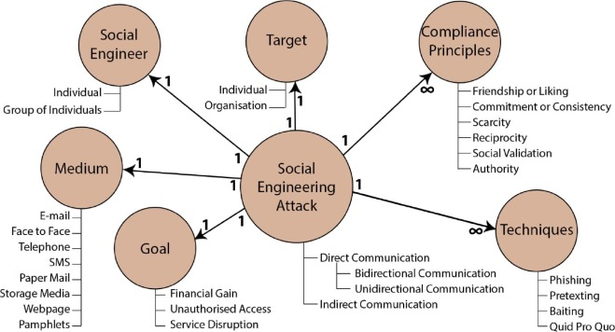

Slide 47
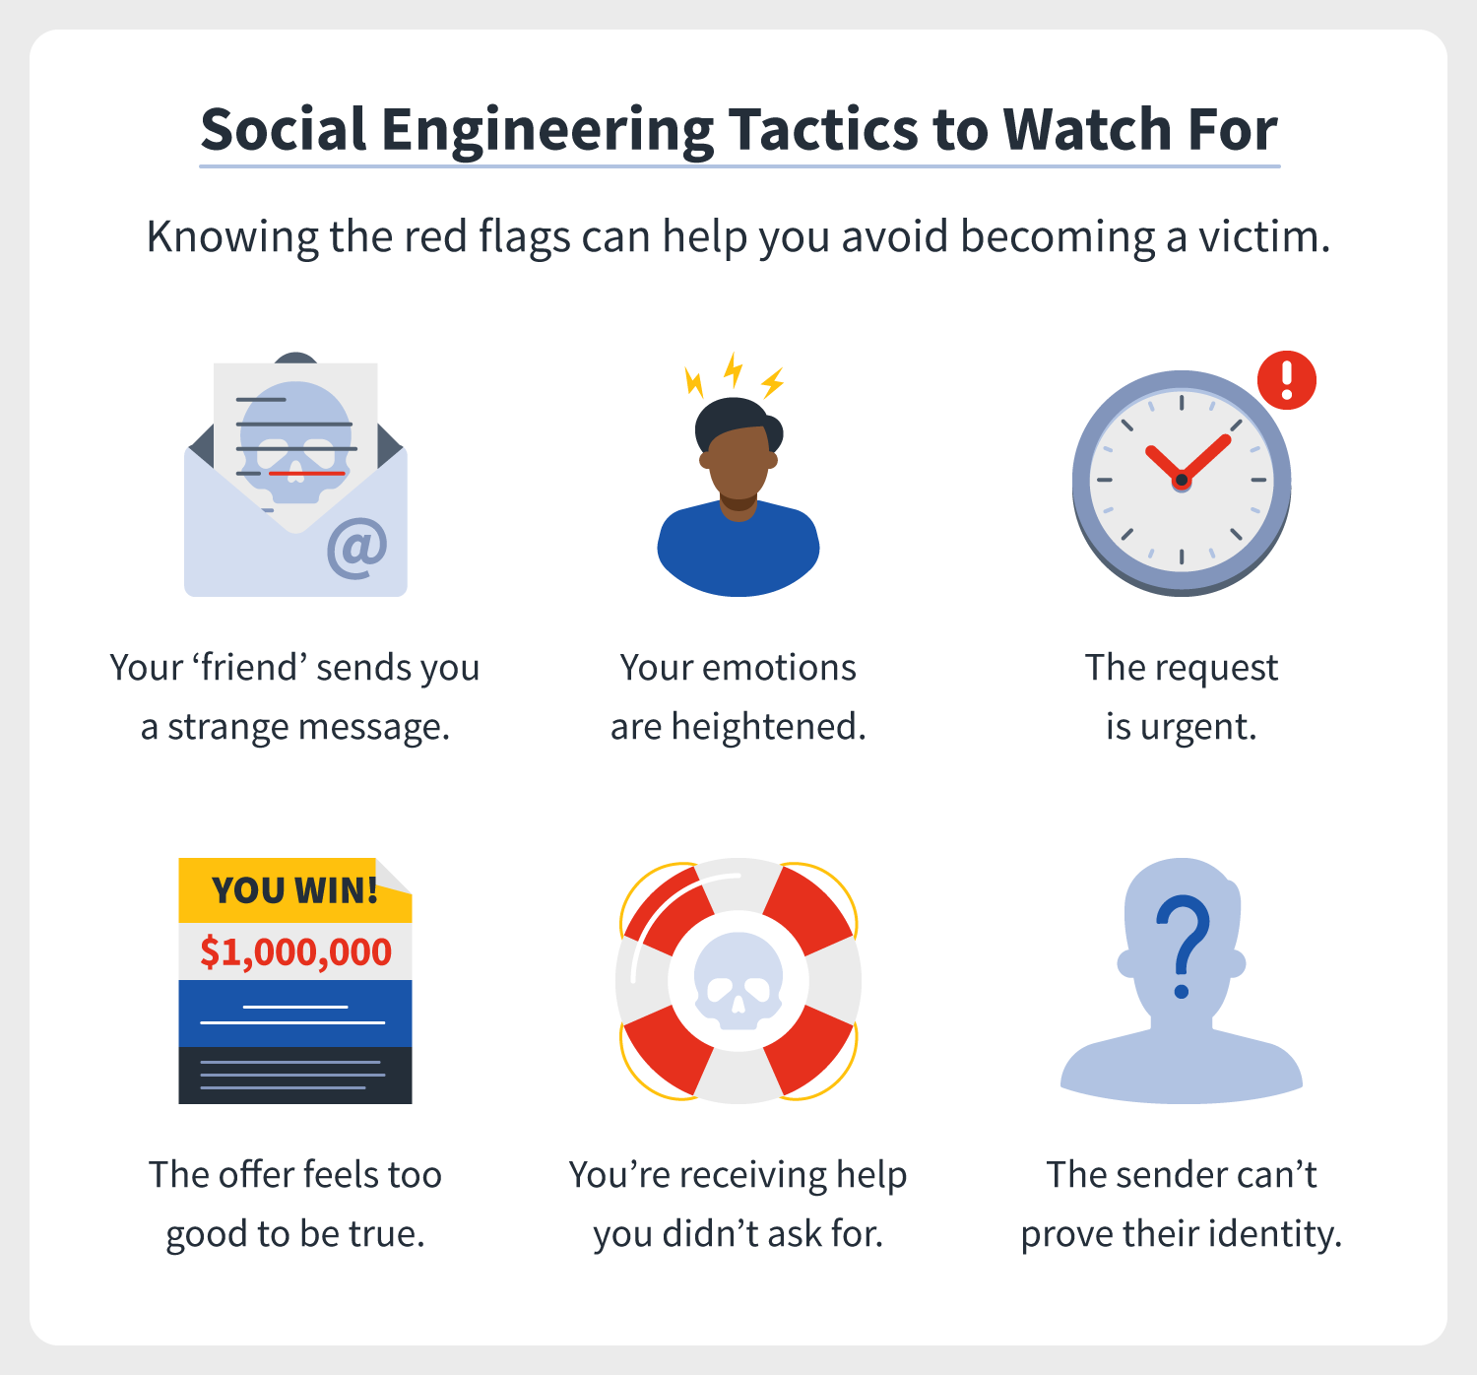

Slide 48
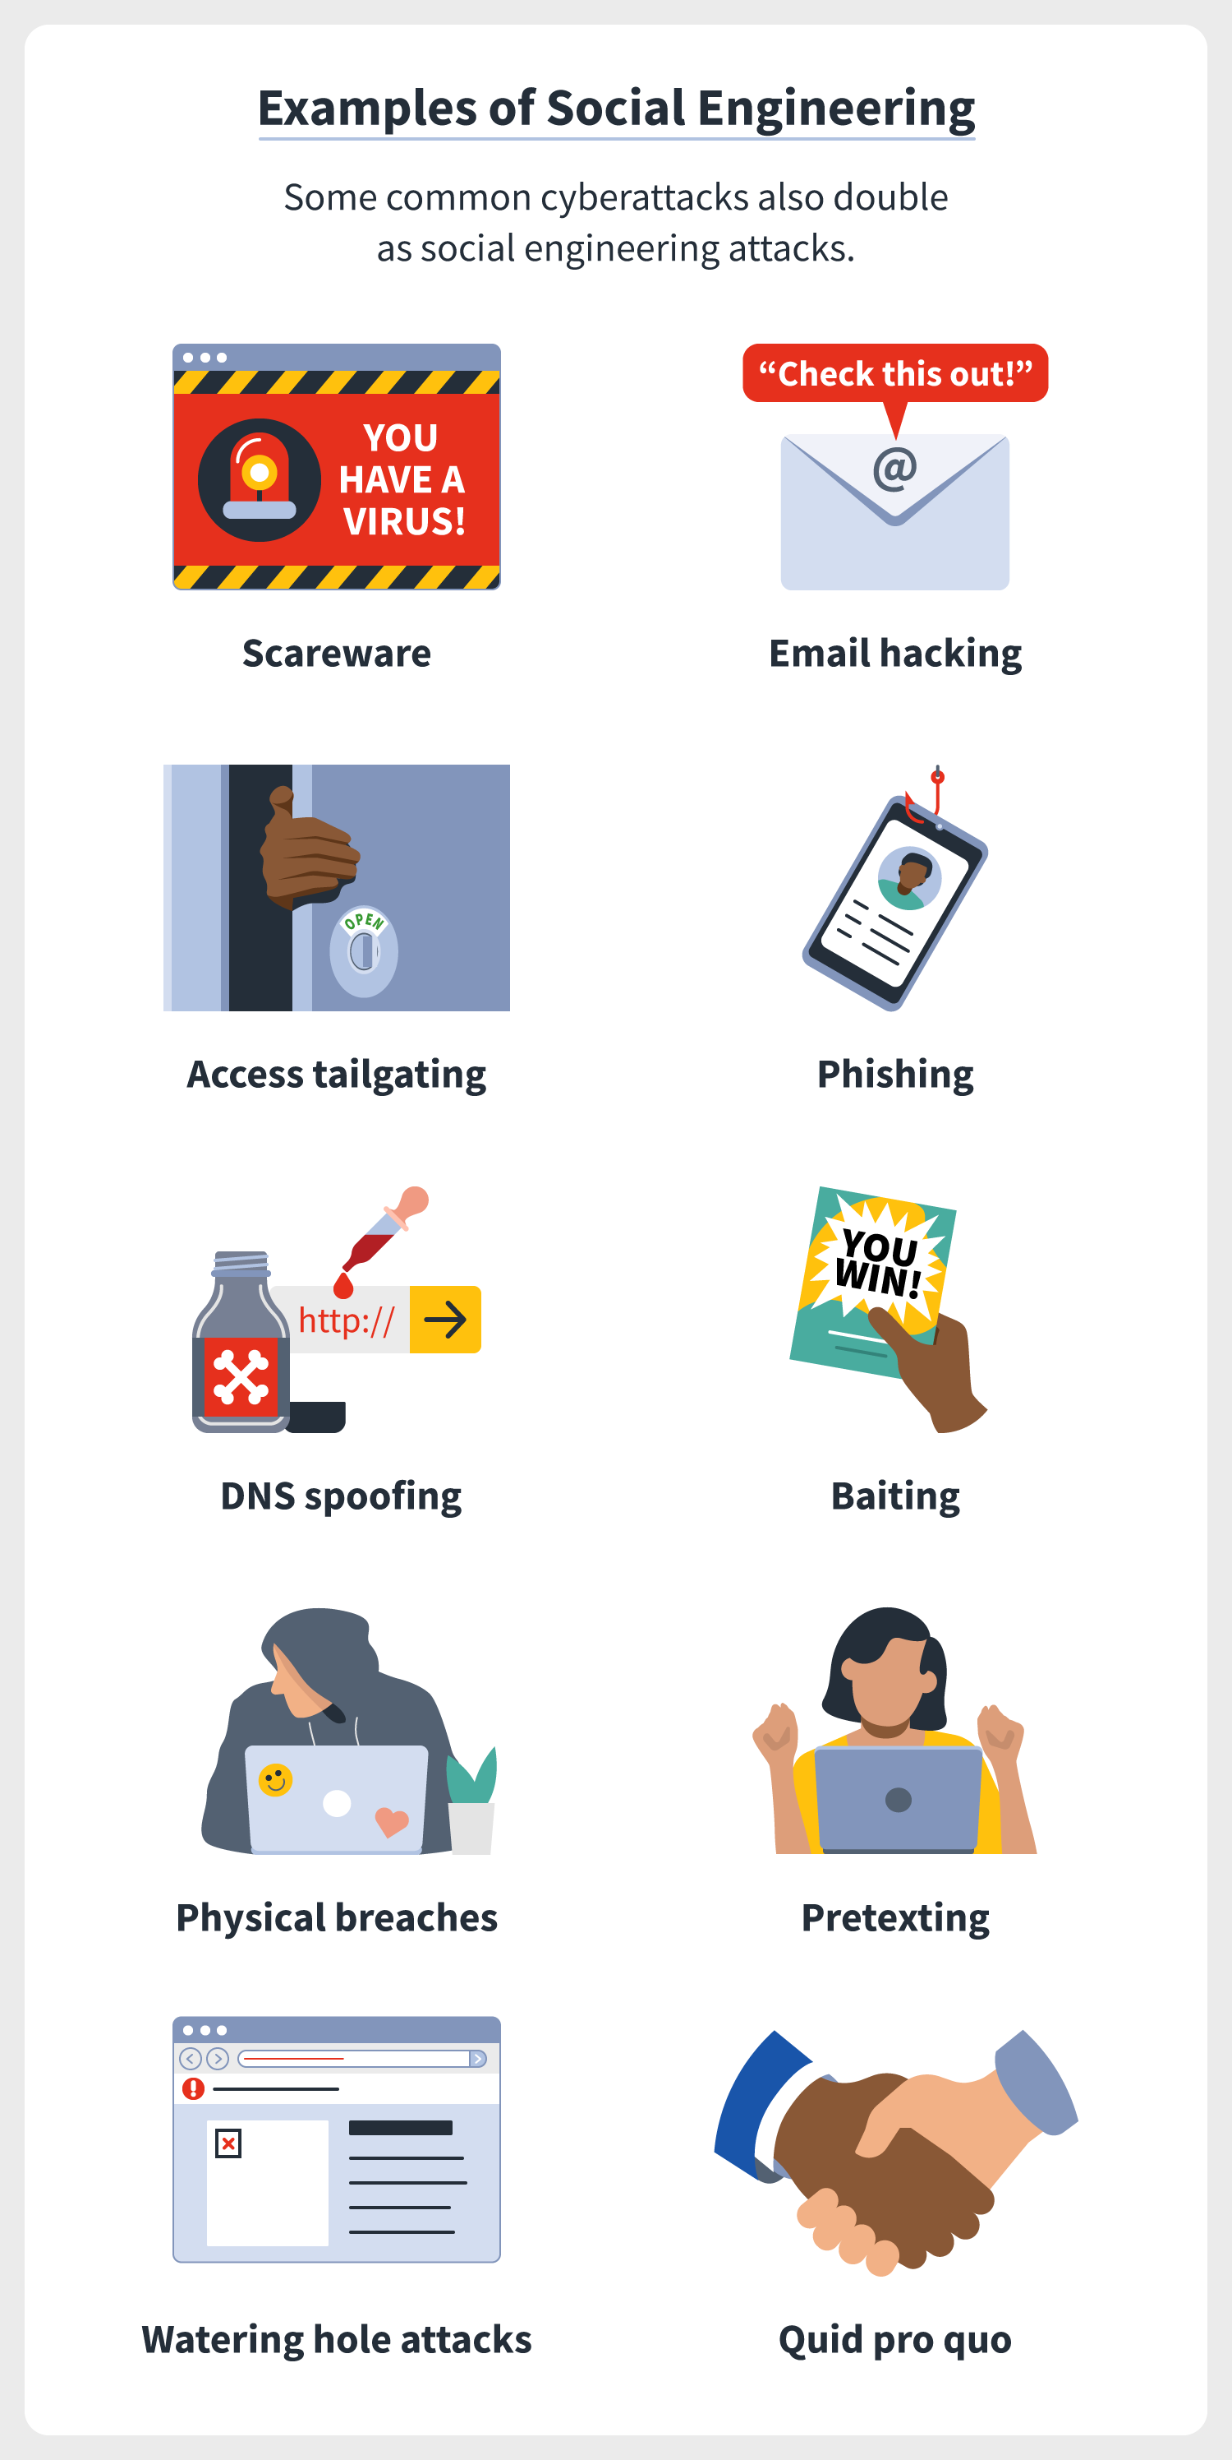

Slide 49
Viruses / Trojan Horses / Worms
Virus is malicious code that can plant itself into operating systems and programs and modify them.
Trojan-horse is a virus that is hidden inside a legitimate software. Once the software is installed or downloaded, the malicious code does its thing.
Worm is industry nomenclature for a self-contained program that will replicate itself across a network, infecting each server and workstation it can access.

Slide 50
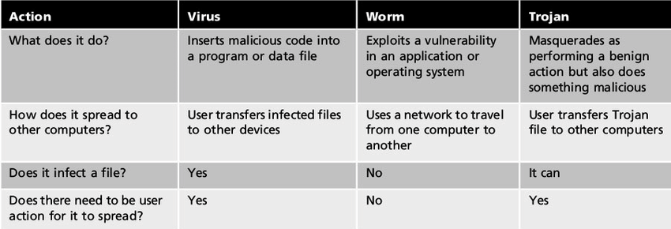

Slide 51
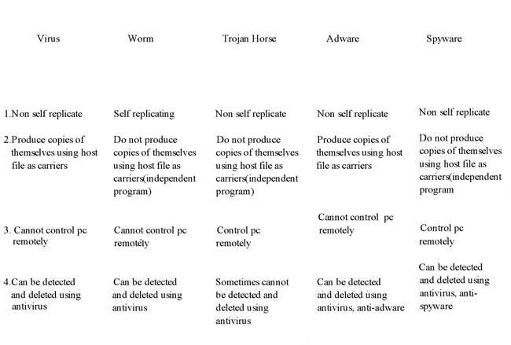

Slide 52
How does computer get a virus?
There are several ways a computer can get infected by a virus and most of them involve downloading – either intentionally or unintentionally – infected files.
Pirated music or movies, photos, free games and toolbars are common culprits, as are phishing/spammy emails with attachments
Notes:
A computer virus is a type of malware that attaches to another program (like a document), which can replicate and spread after a person first runs it on their system. For instance, you could receive an email with a malicious attachment, open the file unknowingly, and then the computer virus runs on your computer. Viruses are harmful and can destroy data, slow down system resources, and log keystrokes.
Cybercriminals aren’t creating new viruses all the time, instead they focus their efforts on more sophisticated and lucrative threats. When people talk about “getting a virus” on their computer, they usually mean some form of malware—it could be a virus, computer worm, Trojan, ransomware or some other harmful thing. Viruses and malware continue to evolve, and often cybercriminals use the type that gives them the best return at that particular time.
“When people talk about “getting a virus” on their computer, they usually mean some form of malware—it could be a virus, computer worm, Trojan, ransomware or some other harmful thing.”
Virus vs. malware
The terms “virus” and “malware” are often used interchangeably, but they’re not the same thing. While a computer virus is a type of malware, not all malware are computer viruses.
The easiest way to differentiate computer viruses from other forms of malware is to think about viruses in biological terms. Take the flu virus, for example. The flu requires some kind of interaction between two people—like a hand shake, a kiss, or touching something an infected person touched. Once the flu virus gets inside a person’s system it attaches to healthy human cells, using those cells to create more viral cells.
A computer virus works in much the same way:
A computer virus requires a host program.
A computer virus requires user action to transmit from one system to another.
A computer virus attaches bits of its own malicious code to other files or replaces files outright with copies of itself.
It’s that second virus trait that tends to confuse people. Viruses can’t spread without some sort of action from a user, like opening up an infected Word document. Worms, on the other hand, are able to spread across systems and networks on their own, making them much more prevalent and dangerous.
Famously, the 2017 WannaCry ransomware worm spread around the world, took down thousands of Windows systems, and raked in an appreciable amount of untraceable Bitcoin ransom payments for the alleged North Korean attackers.
Computer viruses don’t typically capture headlines like that—at least not anymore. They are still a harmful type of malware, but they are not the only type of threat out there today, on your computer or mobile device.

Slide 53
Denial of Service (DoS)
An attack that targets resources within the network with the intention of reserving resource and keeping legitimate users from gaining access.
During a SYN attack, an enemy workstation will generate a flood of session requests using bogus IP addresses.
The target server begins reserving resources for each request while waiting for the completion of the TCP/IP handshake process.
The expected reply from the enemy workstation never comes but the reserved resources results in the denial of service for the legitimate user.
Notes:
If you add it all together, you can see that the target machine allocates resources for more than 3 minutes to respond to just one SYN attack
This DoS attack essentially involves flooding a server with a barrage of hand-crafted requests for connection

Slide 54
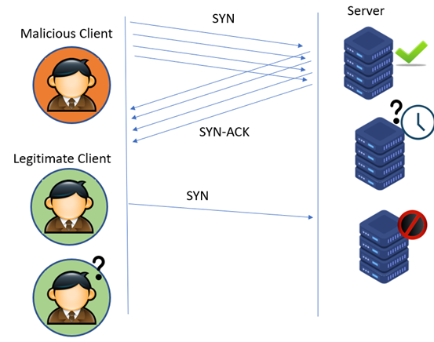

Slide 55
IP Spoofing
IP spoofing is accomplished when an outside hacker uses a discovered IP address to gain access of a trusted environment from outside the network.
A hacker can obtain a valid IP address in a variety of ways such as social engineering.

Slide 56
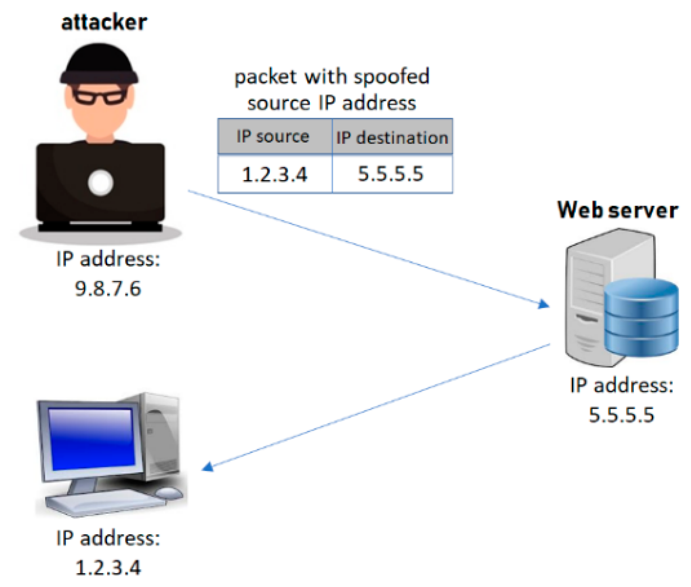

Slide 57
Replay Attack
A replay attack occurs when a hacker intercepts a communication between two parties and replays the message.
For instance, a hacker might intercept a credit card transaction between a consumer and a Web site. The hacker then replays the transaction multiple times resulting in multiple debits to the consumers credit account.

Slide 58
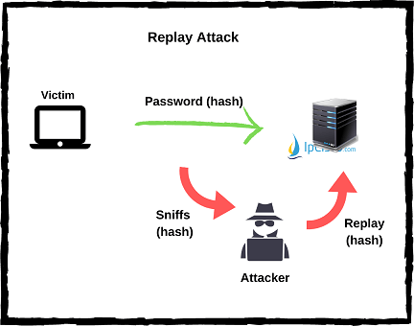

Slide 59
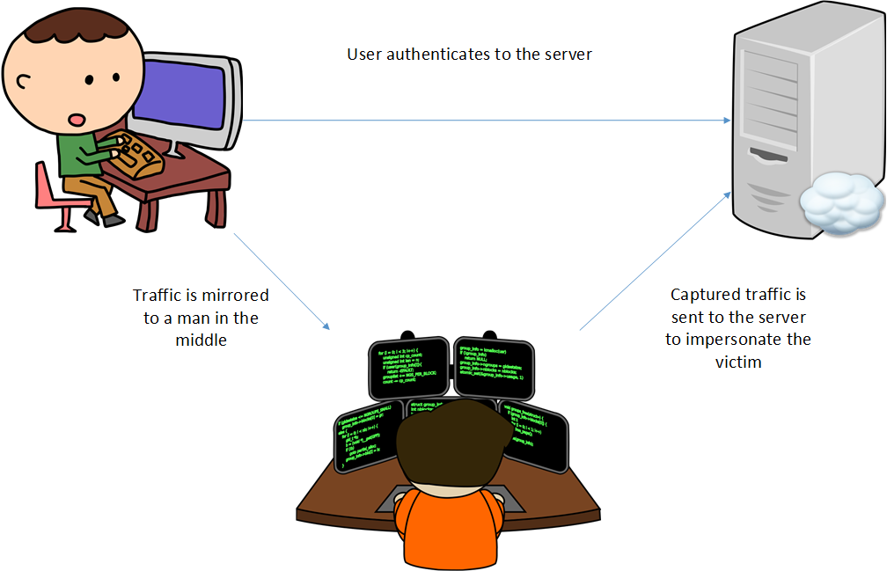

Slide 60
Security Service
  enhance security of data processing systems and information transfers of an organization
  intended to counter security attacks
  using one or more security mechanisms
  often replicates functions normally associated with physical documents
    which, for example, have signatures, dates; need protection from disclosure, tampering, or destruction; be notarized or witnessed; be recorded or licensed
Notes:
Consider the role of a security service, and what may be required.
Note both similarities and differences with traditional paper documents, which for example:
have signatures & dates;
need protection from disclosure, tampering, or destruction;
may be notarized or witnessed;
may be recorded or licensed

Slide 61
Security Services
Confidentiality (privacy)
Authentication (who created or sent the data)
Integrity (has not been altered)
Non-repudiation (the order is final)
Access control (prevent misuse of resources)
Availability (permanence, non-erasure)
  Denial of Service Attacks
  Virus that deletes files

Slide 62
Security Services
X.800:
  “a service provided by a protocol layer of communicating open systems, which ensures adequate security of the systems or of data transfers”
RFC 2828:
  “a processing or communication service provided by a system to give a specific kind of protection to system resources”
Notes:
State here a couple of definitions of “security services” from relevant standards. X.800 defines a security service as a service provided by a protocol layer of communicating open systems, which ensures adequate security of the systems or of data transfers. Perhaps a clearer definition is found in RFC 2828, which provides the following definition: a processing or communication service that is provided by a system to give a specific kind of protection to system resources; security services implement security policies and are implemented by security mechanisms.
RFC stands for "Request for Comment". This refers to a description of a standard for new or modified internet or networking protocols.

Slide 63
Security Services (X.800)
Authentication - assurance that communicating entity is the one claimed
  have both peer-entity & data origin authentication
Access Control - prevention of the unauthorized use of a resource
Data Confidentiality –protection of data from unauthorized disclosure
Data Integrity - assurance that data received is as sent by an authorized entity
Non-Repudiation - protection against denial by one of the parties in a communication
Availability – resource accessible/usable
Notes:
This list is taken from Stallings Table 1.2 which provides details of the 5 Security Service categories and the 14 specific services given in X.800.
This list includes the various "classic" security services which are traditionally discussed. Note there is a degree of ambiguity as to the meaning of these terms, and overlap in their use. The broad service categories are:
authentication is concerned with assuring that a communication is authentic. Two specific authentication services are defined in X.800: Peer entity authentication: provides corroboration of the identity of a peer entity in an association; and Data origin authentication: provides corroboration of the source of a data unit.
access control is the ability to limit and control the access to host systems and applications via communications links.
confidentiality is the protection of transmitted data from passive attacks, and the protection of traffic flow from analysis.
integrity assures that messages are received as sent, with no duplication, insertion, modification, reordering, replay, or loss.
availability is the property of a system / resource being accessible and usable upon demand by an authorized system entity, according to performance specifications for the system.

Slide 64
Security Mechanism
a.k.a. control
feature designed to detect, prevent, or recover from a security attack
no single mechanism that will support all services required
however one particular element underlies many of the security mechanisms in use:
  cryptographic techniques
hence our focus on this topic
Notes:
Now introduce “Security Mechanism” which are the specific means of implementing one or more security services. Note these mechanisms span a wide range of technical components, but one aspect seen in many is the use of cryptographic techniques.
The UMTS Authentication and Key Agreement (AKA) protocol has been designed in such a way that the compatibility with GSM is maximised and a migration from GSM to UMTS is easily possible

Slide 65
Security Mechanisms (X.800)
specific security mechanisms: (May be incorporated into the appropriate protocol layer in order to provide some of the OSI security services)
  encipherment, digital signatures, access controls, data integrity, authentication exchange, traffic padding, routing control, notarization
pervasive security mechanisms: (Mechanisms that are not specific to any particular OSI security service or protocol layer)
  trusted functionality, security labels, event detection, security audit trails, security recovery
Notes:
Some examples of mechanisms from X.800. Note that the “specific security mechanisms” are protocol layer specific, whilst the “pervasive security mechanisms” are not. We will meet some of these mechanisms in much greater detail later.
See Stallings Table 1.3 for details of these mechanisms in X.800, and Table 1.4 for the relationship between services and mechanisms.

Slide 66
Specific security mechanisms
Encipherment
The use of mathematical algorithms to transform data into a form that is not readily intelligible. The transformation and subsequent recovery of the data depend on an algorithm and zero or more encryption keys.
Digital Signature
Data appended to, or a cryptographic transformation of, a data unit that allows a recipient of the data unit to prove the source and integrity of the data unit and protect against forgery (e.g., by the recipient).
Access Control
A variety of mechanisms that enforce access rights to resources.
Data Integrity
A variety of mechanisms used to assure the integrity of a data unit or stream of data units.

Slide 67
Cont….
Authentication Exchange
A mechanism intended to ensure the identity of an entity by means of information exchange.
Traffic Padding
The insertion of bits into gaps in a data stream to frustrate traffic analysis attempts.
Routing Control
Enables selection of particular physically secure routes for certain data and allows routing changes, especially when a breach of security is suspected.
Notarization
The use of a trusted third party to assure certain properties of a data exchange.

Slide 68
Pervasive security mechanisms:
Trusted Functionality
That which is perceived to be correct with respect to some criteria (e.g., as established by a security policy).
Security Label
The marking bound to a resource (which may be a data unit) that names or designates the security attributes of that resource.
Event Detection
Detection of security-relevant events.
Security Audit Trail
Data collected and potentially used to facilitate a security audit, which is an independent review and examination of system records and activities.
Security Recovery
Deals with requests from mechanisms, such as event handling and management functions, and takes recovery actions.
Notes:
Practice Assignment: Drawing tables to map security attacks, services and mechanisms

Slide 69
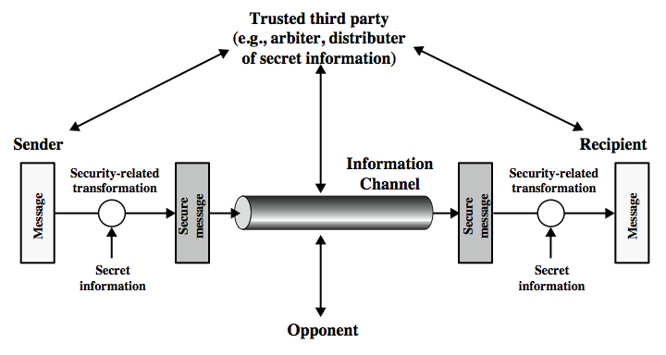
Model for Network Security
Notes:
In considering the place of encryption, its useful to use the following two models from Stallings section 1.6.
The first, illustrated in Figure 1.4, models information being transferred from one party to another over an insecure communications channel, in the presence of possible opponents. The two parties, who are the principals in this transaction, must cooperate for the exchange to take place. They can use an appropriate security transform (encryption algorithm), with suitable keys, possibly negotiated using the presence of a trusted third party. Parts One through Four of this book concentrates on the types of security mechanisms and services that fit into the model shown here.

Slide 70
Model for Network Security
using this model requires us to:
  design a suitable algorithm for the security transformation
  generate the secret information (keys) used by the algorithm
  develop methods to distribute and share the secret information
  specify a protocol enabling the principals to use the transformation and secret information for a security service
Notes:
This general model shows that there are four basic tasks in designing a particular security service, as listed.

Slide 71
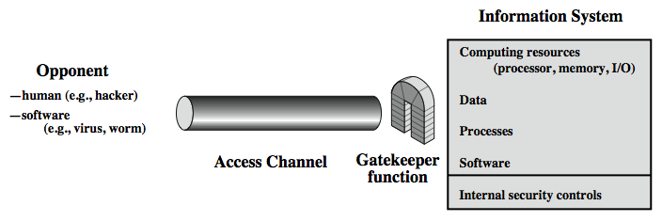
Model for Network Access Security
Notes:
The second, illustrated in Figure 1.5, model is concerned with controlled access to information or resources on a computer system, in the presence of possible opponents. Here appropriate controls are needed on the access to and within the system, to provide suitable security.
The security mechanisms needed to cope with unwanted access fall into two broad categories (as shown in this figure). The first category might be termed a gatekeeper function. It includes password-based login procedures that are designed to deny access to all but authorized users and screening logic that is designed to detect and reject worms, viruses, and other similar attacks. Once either an unwanted user or unwanted software gains access, the second line of defense consists of a variety of internal controls that monitor activity and analyze stored information in an attempt to detect the presence of unwanted intruders. These issues are explored in Part Four.

Slide 72
Model for Network Access Security
using this model requires us to:
  select appropriate gatekeeper functions to identify users
  implement security controls to ensure only authorised users access designated information or resources
note that model does not include:
  monitoring of system for successful penetration
  monitoring of authorized users for misuse
  audit logging for forensic uses, etc.
Notes:
Detail here the tasks needed to use this model.

Slide 73
Summary
topic roadmap & standards organizations
security concepts:
  confidentiality, integrity, availability
X.800 security architecture
security attacks, services, mechanisms
models for network (access) security
Notes:
Chapter 1 summary.

